Slide 1

VOLTAGE REGULATION OF A 3-Φ NON-SALIENT POLE TYPE ALTERNATOR Using MATLAB PROGRAMMING
Presented by :
Sambhav R Jain
107108103
Department of Electricals and Electronics Engineering

Slide 2
Voltage Regulation
Ampere-turns method (M.M.F. method)
Optimistic method
Doesn’t require stator resistance
Two field current components
Phasor addition-graphical method
Synchronous-impedance method (E.M.F. method)
Pessimistic method
Effect of saturation neglected
Calculation of synchronous impedance-analytical method

Slide 3
Ampere-turns method

Slide 4
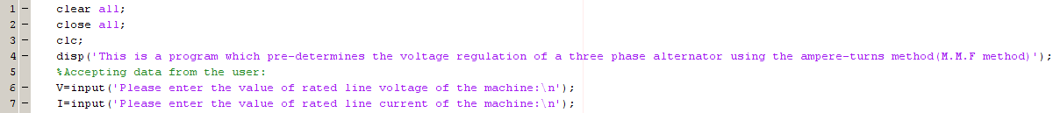
MACHINE PARAMETERS :
Firstly, the machine ratings are accepted from the user as :

Slide 5
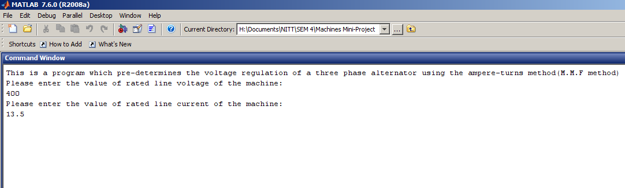
OUTPUT :

Slide 6
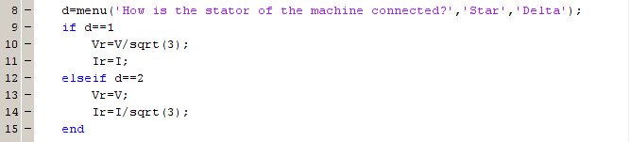
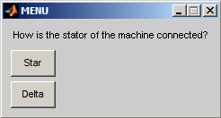
STATOR CONNECTION :
A menu is provided for the user to select from :

Slide 7
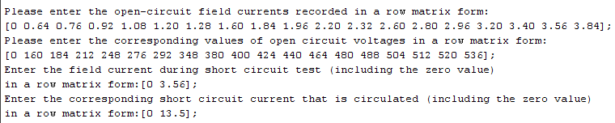
O.C. and S.C. TEST READINGS :
User is now required to enter the open circuit and short circuit test readings in a row-matrix form :

Slide 8
CURVE-FITTING polyfit()

Slide 9
POLYNOMIAL CURVE-FITTING :
To plot the O.C.C of the alternator in MATLAB, a predefined function called polyfit() is used, which evaluates the best fitting curve of a specified degree
We choose a third degree polynomial for least residual error

Slide 10
INTERPOLATION :
Magnitude of field current required for excitation and to overcome leakage reactance is one that corresponds to the rated voltage on the O.C.C.
Magnitude of field current required to overcome armature reaction effect is one that corresponds to rated current on S.C.C.

Slide 11
y=f(x)
y=P₀(1)x³+P₀(2)x²+P₀(3)x+P_{o}(4)
At Vr, the corresponding value of field current is If1
Vr=P₀(1)x³+P₀(2)x²+P₀(3)x+P_{o}(4)
0=P₀(1)x³+P₀(2)x²+P₀(3)x+P_{o}(4)-Vr
P₁=[P₀(1) P₀(2) P₀(3) P_{o}(4)-Vr]

Slide 12
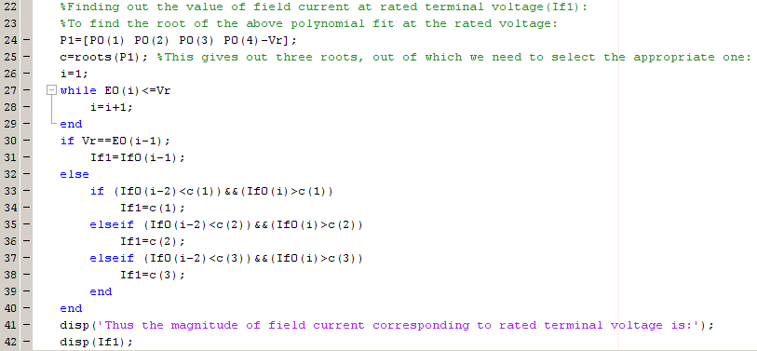
INTERPOLATION :

Slide 13

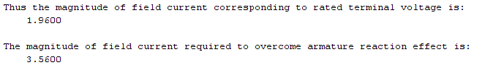
INTERPOLATION :

Slide 14
PLOT TOOLS
plotyy()

Slide 15
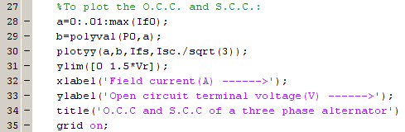
PLOT THE O.C.C. AND S.C.C. :
plotyy() is a function of MATLAB which plots a graph with two independent Y-axes against one X-axis
polyval(P,a) fetches the value of polynomial P at ‘a’

Slide 16
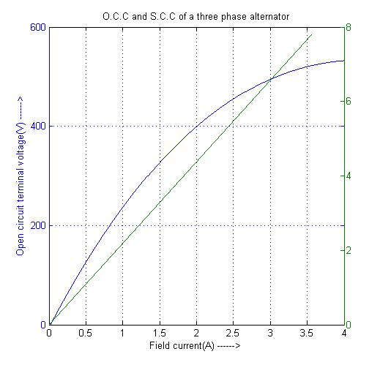
Characteristics :

Slide 17
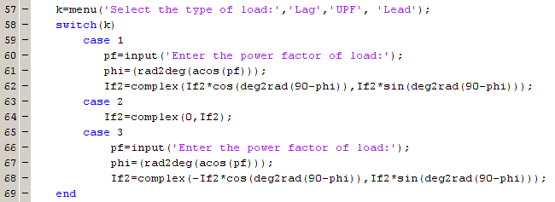
Type of load and power factor :
A menu allows the user to select the type of load and its power factor

Slide 18
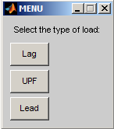
Type of load and power factor :
After selecting the type of load, its power factor is to be specified

Slide 19
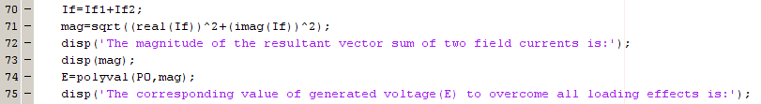
PHASOR ADDITION :
The two field current components are added vectorially and the resultant magnitude is extended on the O.C.C. to find the required generated voltage

Slide 20
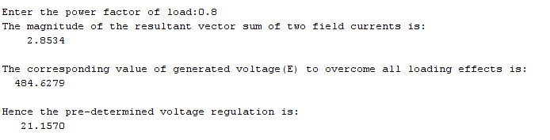
OUTPUT :
Thus the percentage voltage regulation of the alternator is pre-determined at the given loading conditions using the ampere-turns method in MATLAB

Slide 21
Synchronous impedance method

Slide 22
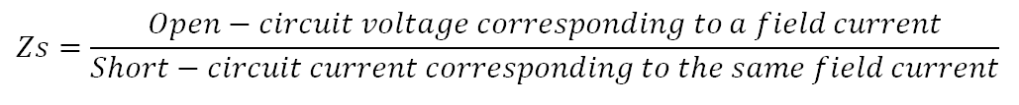
Synchronous impedance, Z_{s}

Slide 23
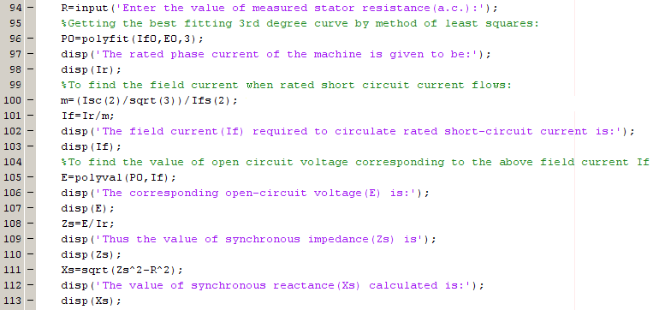
Finding Zs and Xs

Slide 24
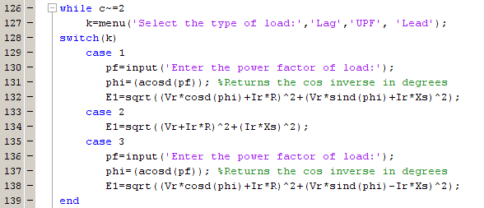
Finding E1 for different power factors

Slide 25
THANK YOU

